Slide 1
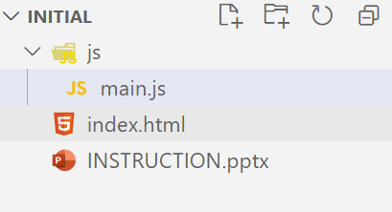
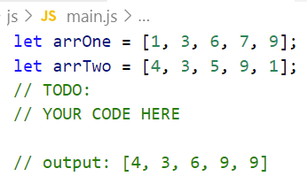
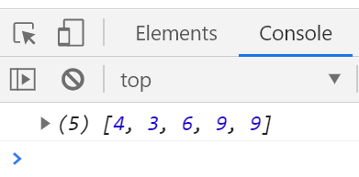
Write code to find maximum of two array.
Example:
Input: [2, 4, 6]
Input: [3, 1, 0]
Output: [3, 4, 6]
Because :
2 < 3 => add 3 to new array
4 > 1 => add 4 to new array
6 > 0 => add 6 to new array
Step:
1. Open exercises folder in Vscode
2. Run index.html file
3. Open Console on browser ( Ctrl + shift + i)
4. Open main.js file and write your JavaScript code

Slide 2
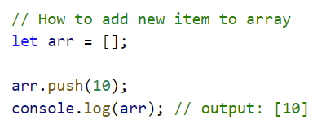
Help!
More details:
https://www.w3schools.com/jsref/jsref_push.asp

